Slide 1
TrustShare: Secure File Sharing System with Cryptographic Access Control Using AES and RSA
COURSE CODE & NAME: CSA5110 CRYPTOGRAPHY AND NETWORK SECURITY
Presented by,
Dharshansrinath.S 192521216
Lingeshwaran V. H 192511442
Sairam D 192424111
Guided by,
DR. NITHISHA

Slide 2
INTRODUCTION
Secure file sharing is essential to protect sensitive information from unauthorized users.
TrustShare encrypts files before storage and allows only authorized users to access shared files.
The system combines modern cryptography and access control techniques to ensure confidentiality, integrity, and secure communication.

Slide 3
OBJECTIVES
Develop a secure file sharing system that protects files using strong encryption and allows access only to authenticated users.
Ensure secure file transfer, integrity verification, and activity monitoring using cryptographic algorithms and role-based access control.

Slide 4
LITERATURE REVIEW
Author | Title | Advantage | Disadvantage | Year
Joan Daemen & Vincent Rijmen | Advanced Encryption Standard (AES) | Provides fast and highly secure file encryption | Symmetric key must be securely shared | 2001
Ronald L. Rivest, Adi Shamir & Leonard Adleman | A Method for Obtaining Digital Signatures and Public-Key Cryptosystems | Secure key exchange and authentication | Slower than symmetric encryption | 1978
NIST | Secure Hash Standard (SHA-256) | Ensures file integrity using hashing | Cannot recover original data from hash | 2015
Niels Provos & David Mazieres | A Future-Adaptable Password Scheme (bcrypt) | Strong password protection against brute-force attacks | Higher computation time | 1999

Slide 5
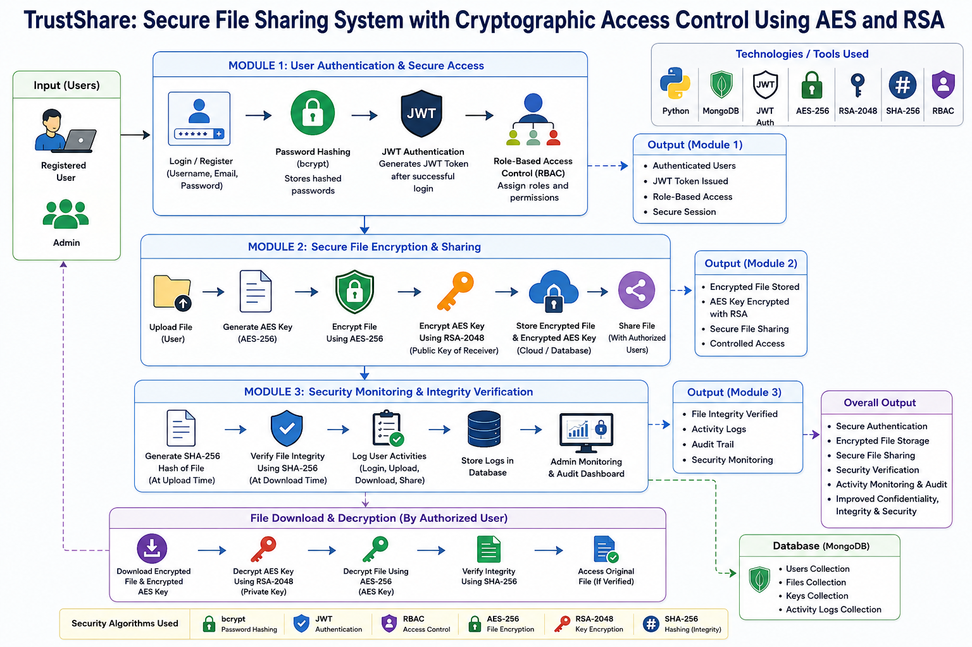
SYSTEM ARCHITECTURE

Slide 6
MODULE 1 : User Authentication & Secure Access
Objective
Authenticate users securely and control access to the system.
Functions
Register and login users securely.
Verify user identity using JWT authentication.
Assign user roles and permissions using RBAC.
Algorithms Used
bcrypt – Encrypts user passwords before storing them.
JWT (JSON Web Token) – Provides secure user authentication.
RBAC (Role-Based Access Control) – Controls what each user can access.
Outcomes
Secure user authentication.
Authorized access based on user roles.

Slide 7
MODULE 2 : Secure File Encryption & Sharing
Objective
Protect files before storage and enable secure sharing between users.
Functions
Encrypt uploaded files before storing.
Share encrypted files with authorized users.
Securely exchange encryption keys.
Algorithms Used
AES-256 – Encrypts file contents quickly and securely.
RSA-2048 – Encrypts and exchanges AES keys securely.
TLS/HTTPS – Protects files during network transfer.
Outcomes
Encrypted file storage.
Secure file sharing with authorized users.

Slide 8
MODULE 3 : Security Monitoring & Integrity Verification
Objective
Verify file integrity and monitor all user activities.
Functions
Verify files using hash values.
Record user login and sharing activities.
Generate audit logs for administrators.
Algorithms Used
SHA-256 – Generates file hash to detect tampering.
Activity Logging – Records all important user actions.
Digital Signature (RSA) – Confirms file authenticity (optional feature).
Outcomes
File integrity verification.
Complete audit trail and activity monitoring.

Slide 9
CONCLUSION
TrustShare provides secure authentication, encrypted file storage, and controlled file sharing using modern cryptographic techniques.
AES, RSA, SHA-256, JWT, and RBAC together ensure confidentiality, integrity, and secure access.
The system improves data security, protects sensitive information, and maintains complete activity logs for better monitoring.

Slide 10
REFERENCES
J. Daemen and V. Rijmen, The Design of Rijndael: AES – The Advanced Encryption Standard. Berlin, Germany: Springer, 2002.
R. L. Rivest, A. Shamir, and L. Adleman, "A Method for Obtaining Digital Signatures and Public-Key Cryptosystems," Communications of the ACM, vol. 21, no. 2, pp. 120–126, Feb. 1978.
National Institute of Standards and Technology (NIST), Secure Hash Standard (SHS), FIPS PUB 180-4, Aug. 2015.
N. Provos and D. Mazieres, "A Future-Adaptable Password Scheme," in USENIX Annual Technical Conference, Monterey, CA, USA, 1999.

Slide 11


